Slide 1
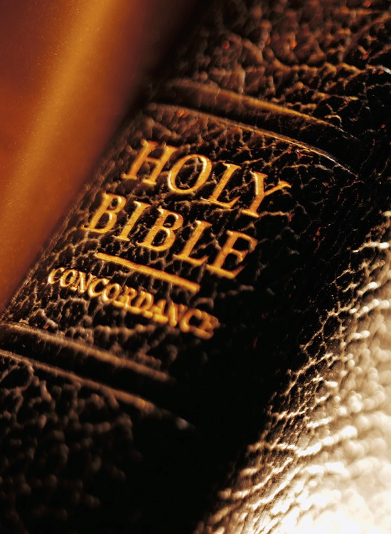
Expository
Excerpts
From Acts 2
(Acts 2:42-47)
Fervor of the Early Church
qualities of the disciples (1)
All Verses Are From The NKJV Unless Noted

Slide 2

Acts 2 Broken Down
2:1-11 – God Keeps His Promises
2:12, 13 – Man’s Slow Heart
2:14-36 – Wisdom in Answering Critics
2:37-41 – The Desired Effect and Plan
2:42-47 – The Fervor of the Early Church
The steadfast practice (2:42)
The qualities of the disciples (2:43-46)

Slide 3

1

Slide 4
1. The Quality Of FEAR
“Then fear came upon every soul, and many wonders and signs were done through the apostles” (Acts 2:43)
  From mocking to admiration and astonishment (2:13)
  Critical in approaching God’s word
  (Is. 66:1-4; Prov. 1:7; 14:27; 19:23; Ps. 119:161)
  “FEAR” with “COMFORT” (Acts 9:31)

Slide 5
1. The Quality Of FEAR
“Then fear came upon every soul, and many wonders and signs were done through the apostles” (Acts 2:43)
  Many miracles → apostles
    As Jesus had done (Acts 2:22)
    PURPOSE: confirm the message
    (Jn. 5:36; 10:25, 37, 38; Heb. 2:3, 4; 1 Cor. 13:10)
      Example, Acts 13:6-12

Slide 6
Fearlessness towards God (Ps. 36:1-4; Prov. 8:13; Ex. 20:20)

Slide 7

“And Moses said to the people, ‘Do not fear; for God has come to test you, and that His fear may be before you, so that you may not sin’” (Ex. 20:20)
FEAR OF GOD

Slide 8
Fearlessness towards God (Ps. 36:1-4; Prov. 8:13; Ex. 20:20)
Fearfulness of man (Rev. 21:8; Matt. 10:25-28; Prov. 29:25)
Fearfulness of death (Heb. 2:15; Rev. 2:10)

Slide 9
What Is Keeping YOU From Serving God Today?

